Slide 1

BEACON Labs Workshop - Lab 1
Middlebox Amplification Attack Network Security Lab
Gaby Dagher, PhD ISPM Research Lab Boise State University
Dylan Gresham ISPM Research Lab Boise State University
Created by: Jordan Whyte, ISPM Research Lab
Notes:
Hello everyone! Welcome to the BEACON Labs Workshop created under Boise State University’s ISPM Research Lab, directed by Dr. Gaby Dagher. My name is Dylan Gresham and I’ll be the one guiding everyone through the workshop.

Slide 2
Source Paper
Title: Weaponizing Middleboxes for TCP Reflected Amplification
Authors: Kevin Bock et al.
Conference: USENIX Security
Year: 2021
[Distinguished Paper Award Winner and Third Prize winner of the 2021 Internet Defense Prize]

Slide 3
Preparation
Download & Install Oracle VirtualBox
Download Virtual Machine Images
Open the Instruction Document
Notes:
To get started, I just want to make sure that everyone has gotten VirtualBox installed, the three accompanying virtual machine images downloaded, and the instruction document opened up as well. If not, go ahead and get those downloads started and we will continue on. If you’re unable to get things installed before we get to the actions, feel free to follow along and take notes and attempt it on your own time or post a message in the chat and try and group up with someone else who does have everything installed.

Slide 4
Overview
Introduce recent advances in attacks
Activities
Network Security (NS) - Reflection-Based Attacks
Mobile Security (MS) - Mobile Security Exploits
Web Security (WS) - XSS and Service Workers
Game Theory
Notes:
Ok, so just to give a brief overview of what this workshop is all about. We’ll be introducing some advances in attacks in network and web security today and mobile security tomorrow. All of these attacks have been published from within the last 5 years and are still relevant today. Our first activity will be a TCP reflection-based attack, following that will be an attack taking advantage of the Android API to hijack physical input mechanisms. Tomorrow we’ll finish up by going over a cross-site scripting attack executed via service workers.

Slide 5
Goals
For each of the cyber threats we examine in our activities, students should be able to:
Analyze them
Implement them
Think about how to defend against them
Gain practical insights
Notes:
The goal of this workshop is to get our students to be able to analyze these attacks, implement them, and start thinking about how to defend against them, all while gaining practical insights into these topics.
Before we begin, are there any questions?

Slide 6
NS - Middlebox: Overview
Previously only possible in UDP
Now possible through TCP
Implementation dependent
Middleboxes!
Firewalls, routers, “things in between”
“Weaponizing middleboxes for TCP reflected amplification” in the 30th USENIX Security Symposium pages 3345-3361
Notes:
Up until this paper was released in 2021, reflection based attacks were thought to only be possible through UDP. This paper proved them to be possible through TCP as well. With that being said, it relies on the implementation of the protocol and not in a vulnerability in the protocol itself. The attack is performed through middleboxes, which are the devices that sit between one person and another on the internet. A middlebox could be a firewall, a router, another server, or some random device sitting in a coffee shop.

Slide 7
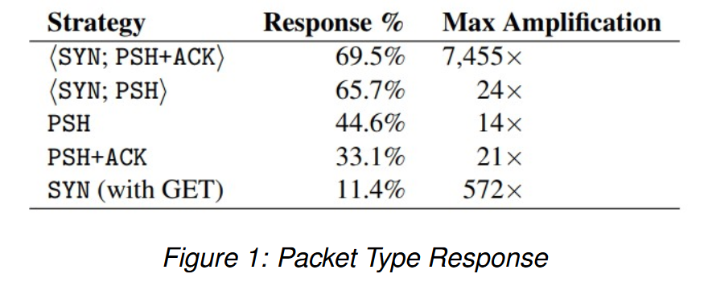
NS - Middlebox: Overview
Notes:
Here we can see some of the different strategies the researches used for the packets. They tried combining different flags and checked how many responses they got and how much of an amplification was in the response itself.

Slide 8
NS - Middlebox: Overview
Destination Reflection
Middlebox Reflection
Destination & Middlebox Reflection
Routing Loop Reflection
Victim-Sustained Reflection
Notes:
There are five types of reflection attacks.
Destination reflection which results in a direct response of a static size.
Middlebox reflection which results in a block page of static size (more than destination reflection).
Destination & Middlebox reflection is a combination of the previous two, size is equivalent to destination + middlebox sizes.
Routing Loop reflection is where all routers that a packet travels through produces a middlebox response and loop back to each other.
Victim-Sustained reflection is where the victim responds to the packets, prompting the destination for another response. Since the victim never sent the request themselves, this results in a long series of interactions, sometimes leading to an “infinite amplification factor.”

Slide 9
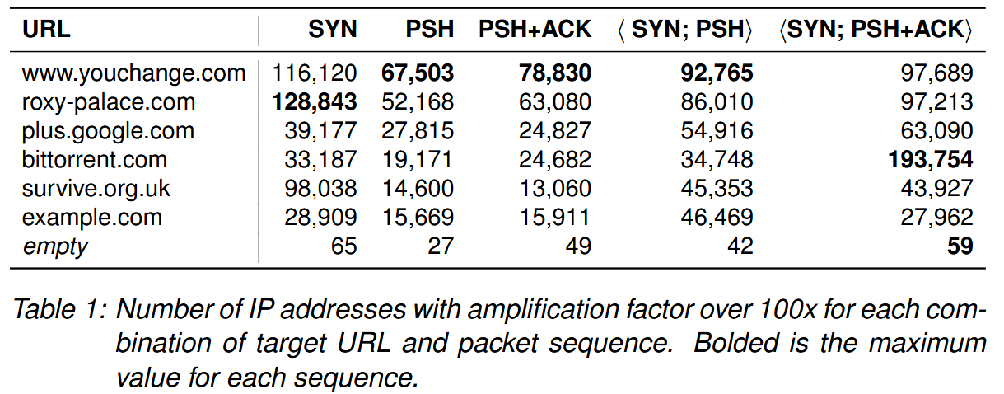
NS - Middlebox: Overview
Notes:
Now in this table we can see several different URLs that resulted in an amplification factor of +100x for each flag combination. The main thing to note here are the bolded values representing the URL that produced the most responses with that combination of flags.

Slide 10
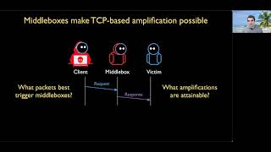
NS - Middlebox: Overview

Slide 11
Match the diagrams to their corresponding type of amplification.
NS - Middlebox: Action 1.1.1
Notes:
In this first task set, we’re focusing on matching visual representations of the different type of reflection attacks to the type.

Slide 12
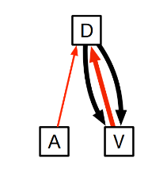
NS - Middlebox: Action 1.1.1
Match the diagrams below to its corresponding type of amplification.
Destination Reflection
Middlebox Reflection
Destination & Middlebox Reflection
Routing Loop Reflection
Victim-Sustained Reflection
Notes:
Take a minute to figure out what type of reflection this is.

Slide 13
NS - Middlebox: Action 1.1.1
Match the diagrams below to its corresponding type of amplification.
Destination Reflection
Middlebox Reflection
Destination & Middlebox Reflection
Routing Loop Reflection
Victim-Sustained Reflection
Notes:
This is a victim-sustained reflection. The attacker sends a packet to the destination which then prompts a response to the victim. The victim then responds back and starts a loop of responses between the victim and destination.

Slide 14
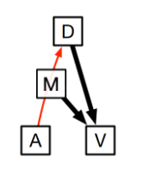
NS - Middlebox: Action 1.1.1
Match the diagrams below to its corresponding type of amplification.
Destination Reflection
Middlebox Reflection
Destination & Middlebox Reflection
Routing Loop Reflection
Victim-Sustained Reflection
Notes:
Take a minute for this one.

Slide 15
NS - Middlebox: Action 1.1.1
Match the diagrams below to its corresponding type of amplification.
Destination Reflection
Middlebox Reflection
Destination & Middlebox Reflection
Routing Loop Reflection
Victim-Sustained Reflection
Notes:
Here we’ve got an example of a destination & middlebox reflection. We’ve got the attacker sending a packet to the destination and in the process of arriving at the destination, it passes through a middlebox which also sends a response to the victim, causing the victim to get responses from two sources.

Slide 16
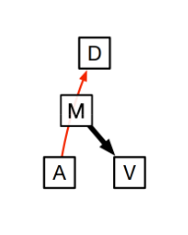
NS - Middlebox: Action 1.1.1
Match the diagrams below to its corresponding type of amplification.
Destination Reflection
Middlebox Reflection
Destination & Middlebox Reflection
Routing Loop Reflection
Victim-Sustained Reflection
Notes:
Take a minute to try this one.

Slide 17
NS - Middlebox: Action 1.1.1
Match the diagrams below to its corresponding type of amplification.
Destination Reflection
Middlebox Reflection
Destination & Middlebox Reflection
Routing Loop Reflection
Victim-Sustained Reflection
Notes:
This one is just middlebox. The attacker sends a packet to the destination which doesn’t send a response to the victim but the middlebox that the packet passed through on its way to the destination did send a response to the victim.

Slide 18
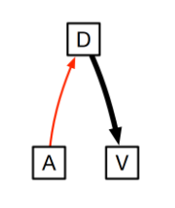
NS - Middlebox: Action 1.1.1
Match the diagrams below to its corresponding type of amplification.
Destination Reflection
Middlebox Reflection
Destination & Middlebox Reflection
Routing Loop Reflection
Victim-Sustained Reflection
Notes:
Now take a second for this one.

Slide 19
NS - Middlebox: Action 1.1.1
Match the diagrams below to its corresponding type of amplification.
Destination Reflection
Middlebox Reflection
Destination & Middlebox Reflection
Routing Loop Reflection
Victim-Sustained Reflection
Notes:
Hopefully, we got that this is a destination reflection. The attacker is sending a packet to the destination. Destination then sends a response to the victim.

Slide 20
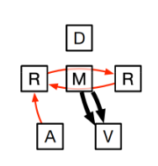
NS - Middlebox: Action 1.1.1
Match the diagrams below to its corresponding type of amplification.
Destination Reflection
Middlebox Reflection
Destination & Middlebox Reflection
Routing Loop Reflection
Victim-Sustained Reflection
Notes:
Last but not least, take a second or two for this one.

Slide 21
NS - Middlebox: Action 1.1.1
Match the diagrams below to its corresponding type of amplification.
Destination Reflection
Middlebox Reflection
Destination & Middlebox Reflection
Routing Loop Reflection
Victim-Sustained Reflection
Notes:
Here we’ve got a case of a routing loop reflection. The attacker sends a packet to the destination but along the way, a router picks it up and sends it through a middlebox to another router. The middlebox then sends a response to the victim and the second router sends the packet back to the first router. The router then continuously sends the packet back and forth between routers causing the middlebox to shell out a ton of responses to the victim.

Slide 22
NS - Middlebox: Task Set 2
Classifying IP addresses depending on what type of reflection was produced.
Notes:
Now we’re going to utilize the Java application in the virtual machine to classify IP addresses based on the type of reflection.

Slide 23
NS - Middlebox: Task Set 2
Open “Middlebox-VM” in VirtualBox
Login with username and password “middlebox”
Case sensitive
Open a terminal
Enter the command “middlebox”
Notes:
If you haven’t already, open up the middlebox vm in virtualbox and log in with the username and password middlebox, all lowercase and all one word. Once logged in, go ahead and open a terminal and enter the command middlebox to start the program.

Slide 24
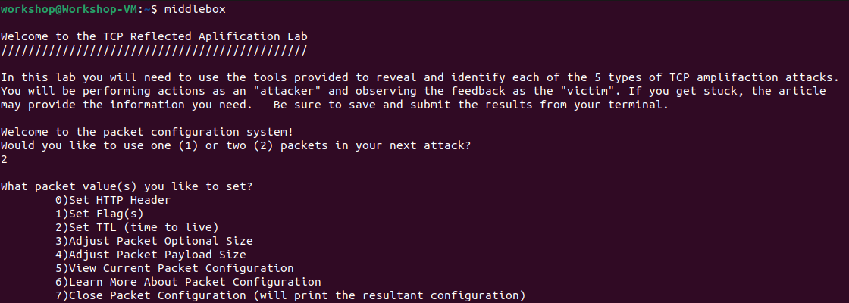
NS - Middlebox: Action 2.1.1
Start the program and choose to use 2 packets.
Notes:
Once the program is started, read through the text and then choose to use 2 packets. Your terminal’s output should look similar to what is shown on screen.

Slide 25
NS - Middlebox: Task Set 2
HTTP Header
Domain
Flags
Hint, check the table and figures!
Time to Live (TTL)
Packet Size
Payload Size
Notes:
Now we need to set the packet up. We’ll be setting the HTTP Header, which corresponds to the domain that we’ll be simulating sending a packet to, the flags, which we can determine by looking at the tables and figures in the instruction document, the packet’s time to live, size, and the payload’s size.

Slide 26
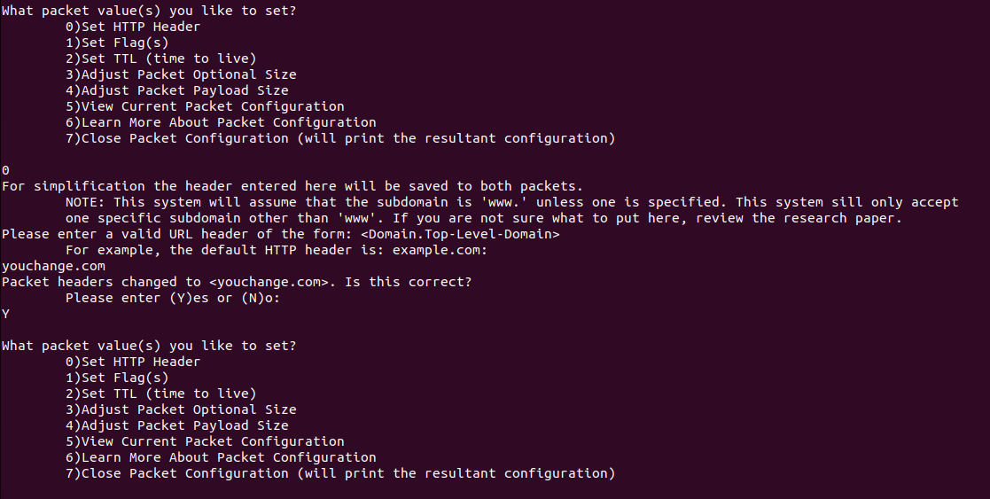
NS - Middlebox: Action 2.1.2
Choose to set the HTTP Header and enter “youchange.com” as the domain name.
Notes:
First off, let’s all use the domain “youchange.com”. Select the option 0 and enter yoochange.com then hit enter and the letter y to confirm. Now I am obligated to mention that this domain was changed from the paper’s source material. Originally it was an adult film website which was deemed inappropriate for educational purposes so for this workshop we’ve changed it to youchange instead of its original name.

Slide 27
NS - Middlebox: Action 2.1.3
Choose to set the Flag(s) and set the appropriate flags you want to set.
First Packet
Second Packet
Notes:
Now for each packet we need to set the appropriate flags. Use the tables shown earlier in the slides and the instruction document and choose two sets of flags to set, one for each packet. They can be the same if you wish them to be.

Slide 28
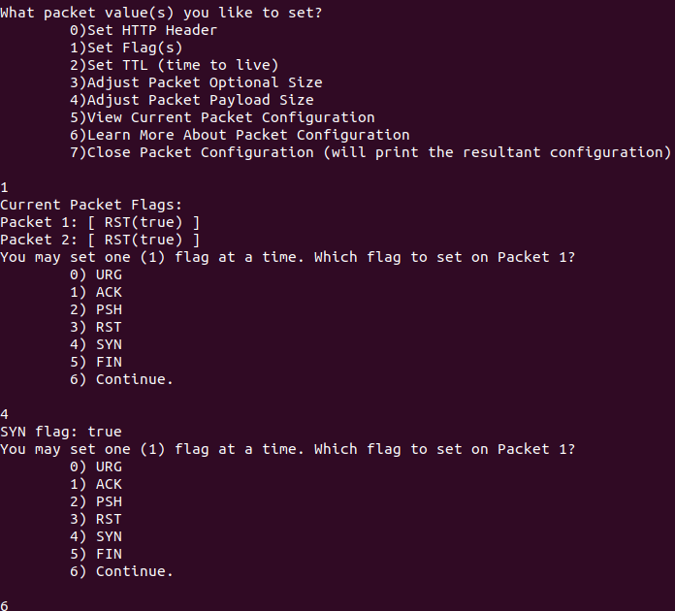
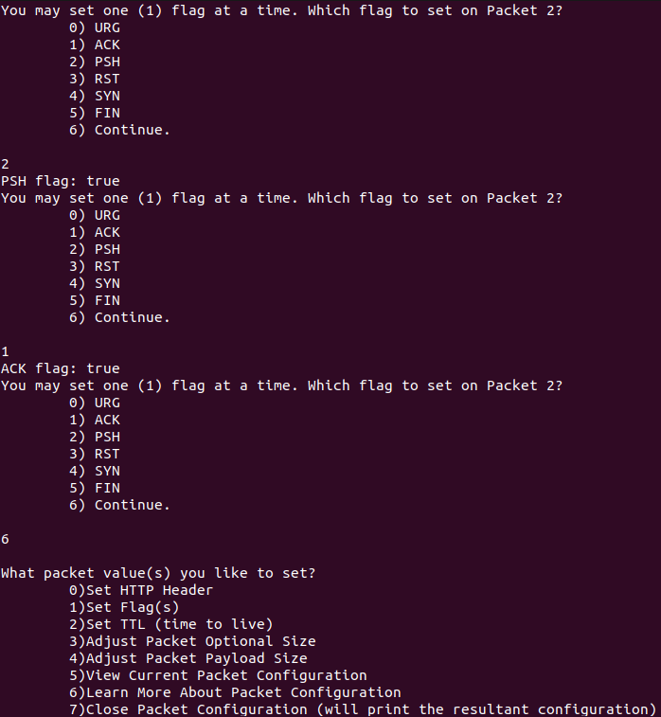
NS - Middlebox: Action 2.1.3
Choose to set the Flag(s) and set the appropriate flags you want to set.
First Packet
Second Packet
Notes:
For the sake of consistency, please set the first packet to just have the SYN flag and the second packet to have the PSH and ACK flags.

Slide 29
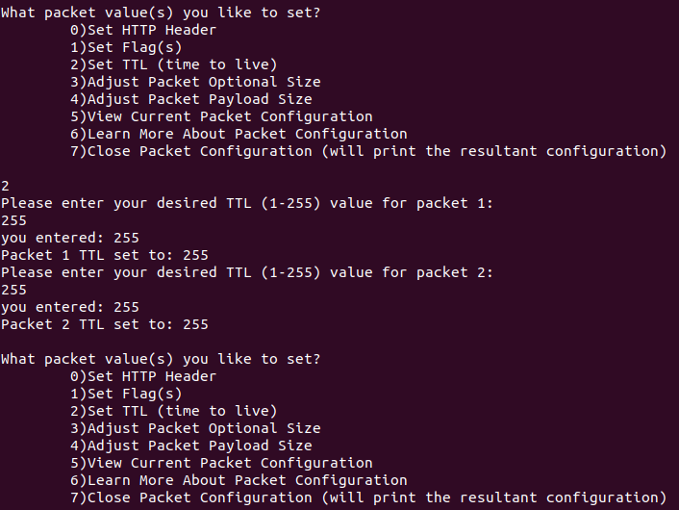
NS - Middlebox: Action 2.1.4
Choose to set the time to live (TTL) and choose the longest possible time.
Notes:
Now we’ll be setting the time to live to as long as possible which is 255 for both packets.

Slide 30
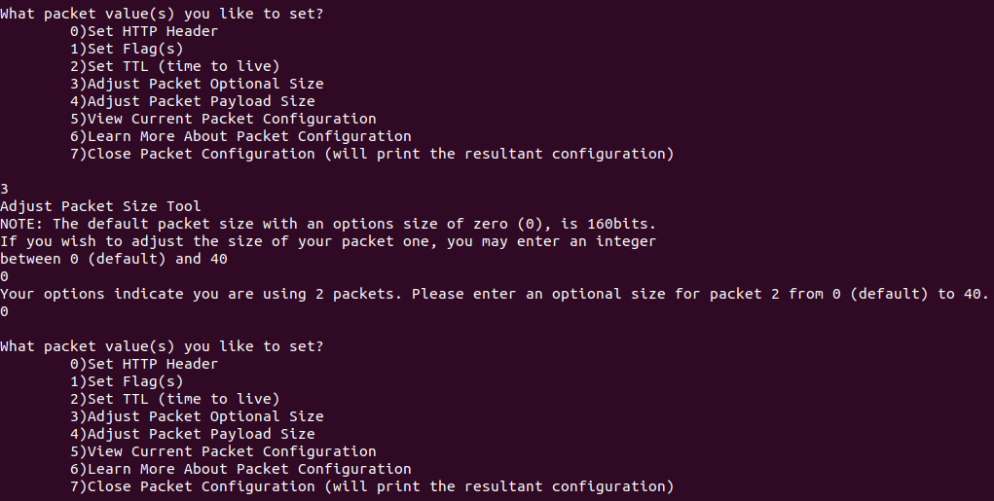
NS - Middlebox: Action 2.1.5
Choose to adjust packet optional size and choose the default size.
Notes:
We’ll then make sure that the packet size is the default.

Slide 31
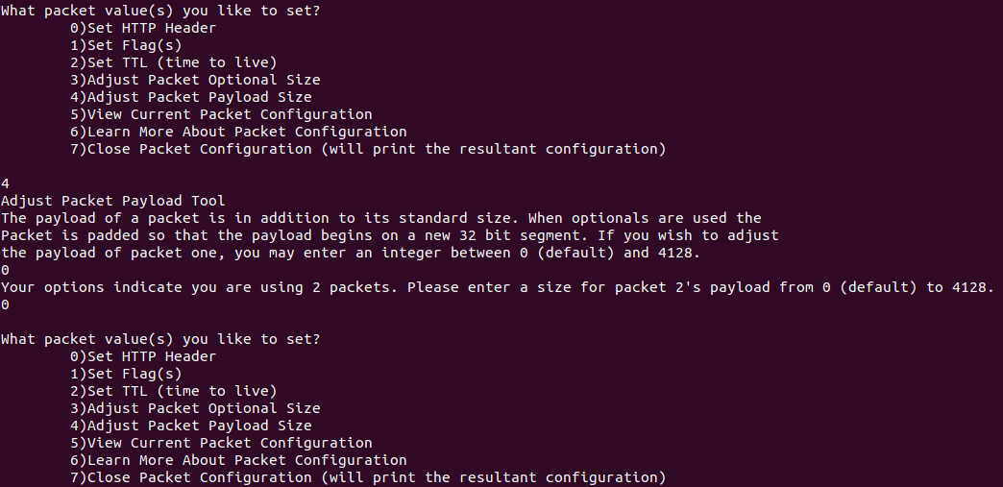
NS - Middlebox: Action 2.1.6
Choose to adjust the packet payload size and choose the default size.
Notes:
Then we’ll make sure that the payload size is also the default.

Slide 32
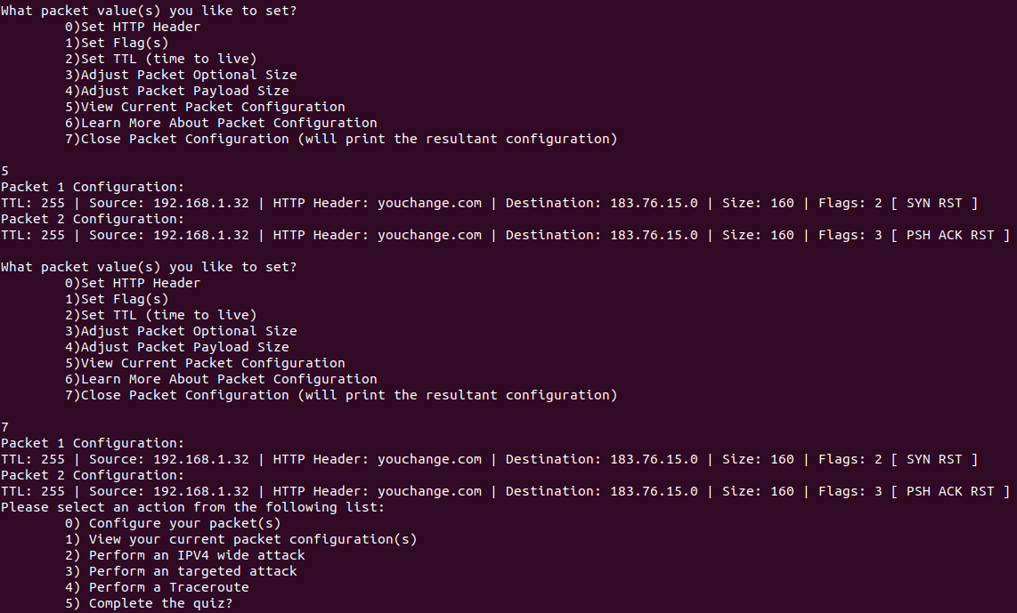
NS - Middlebox: Action 2.1.7
View your packet configuration and then close the packet configuration once you’re satisfied.
Notes:
Now we’ve set up our packet, let’s print out our configuration to double check everything and then close the configuration. Take a moment to double check that you’ve got everything the same as what I’ve got, otherwise it may throw the rest of the lab off. This guided walkthrough will be to get a 100% score on the final quiz but, students may need to try out more than one packet configuration to get enough data.

Slide 33
NS - Middlebox: Task Set 2
Wide Attack
Sent your crafted packet to all IP addresses
Targeted Attack
Send your crafted packet to one IP address
Traceroute
Send your crafted packet to one IP address and observe the route it took to arrive at the destination
Notes:
Now that we’ve got our packets configured, we have multiple options of what to do next. We can either perform a wide attack which will send our packets to every single IP address. We can do a targeted attack in which we send our packets to a single address. Or we can do a traceroute where we send our packets to one address and be able to see the route it took to get to the destination.

Slide 34
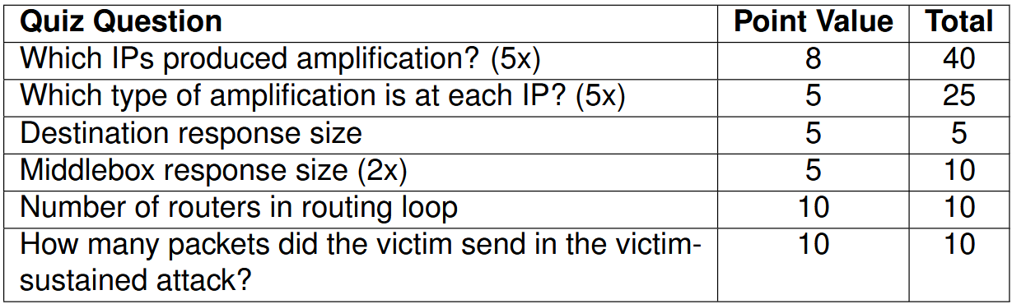
NS - Middlebox: Task Set 2
What you need to know for the quiz
Notes:
Now the end of this activity has a quiz that we’ll need to do in order to “pass” the activity. For this quiz, we need to know all five IP addresses that produced an amplification, which type of amplification each address is, the size of the destination amplification, both of the middlebox response sizes since there’s the middlebox amplification and the destination and middlebox reflection, the number of routers in the routing loop amplification, and how many packets the victim sent in the victim-sustained attack. While that sounds like a lot, following the steps we’ll go through will allow us to get everything in a systematic way

Slide 35
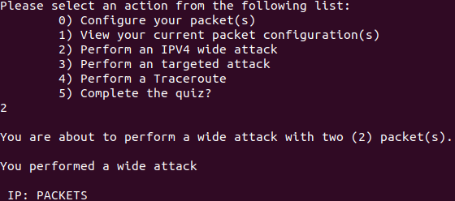
NS - Middlebox: Action 2.2.1
Complete an IPv4 wide attack and note down the 5 IP addresses that resulted in an amplification attack.
From your long list of IP addresses, find the 5 that don’t have 1 as the number of packets and note down the IP address and number of packets.
Notes:
Our first step is to do a wide attack and jot down the 5 IP addresses that resulted in an amplification attack. I’ve already gone ahead and done so here, but take a few minutes to do it yourself and sort through the IPs to find your five. As you find each IP address, make sure you write it down either on a piece of scratch paper or a text file on your computer or virtual machine.

Slide 36
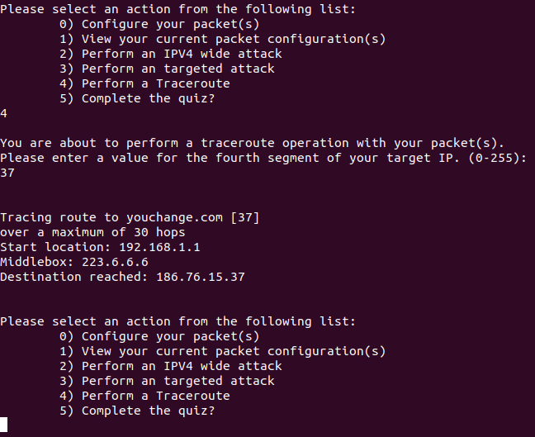
NS - Middlebox: Action 2.2.2
For each of the 5 IP addresses, perform a Traceroute and save the results.
Notes:
Now that we’ve got all five, we need to perform a traceroute on each one to determine its path. This will give us more clues as to which IP address was a victim of which type of reflection. Take a few minutes to go through each of yours and then we’ll go through what I’ve got. For each traceroute, it is a good idea to save the details of the traceroute to another file by copy pasting or writing down the essential details manually.

Slide 37
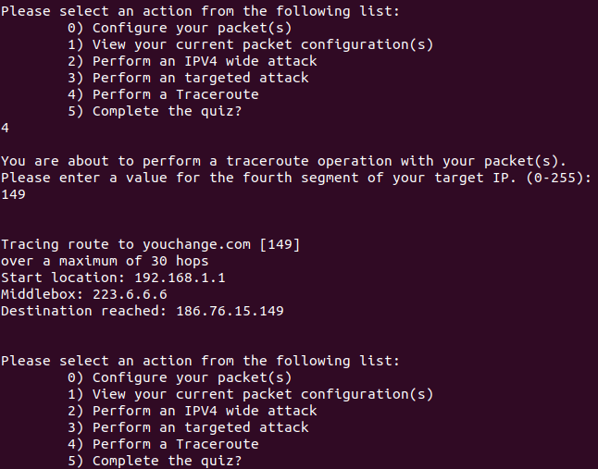
NS - Middlebox: Action 2.2.2
For each of the 5 IP addresses, perform a Traceroute and save the results.

Slide 38
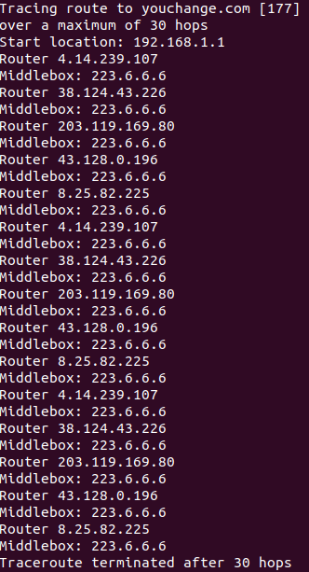
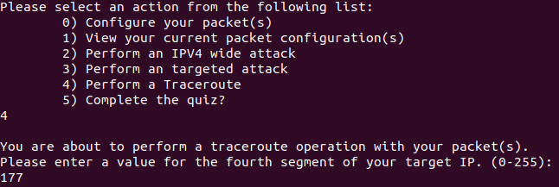
NS - Middlebox: Action 2.2.2
For each of the 5 IP addresses, perform a Traceroute and save the results.

Slide 39
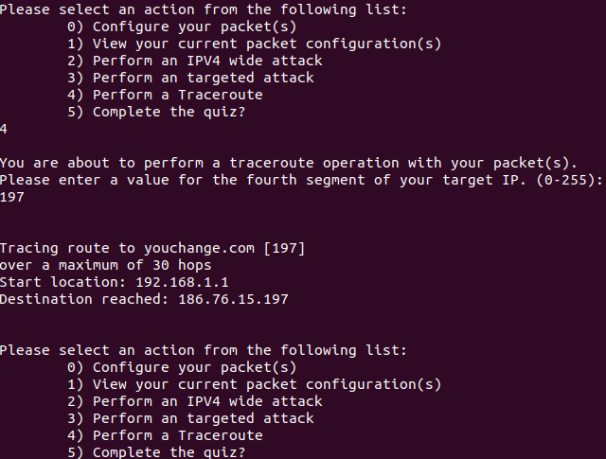
NS - Middlebox: Action 2.2.2
For each of the 5 IP addresses, perform a Traceroute and save the results.

Slide 40
NS - Middlebox: Action 2.2.3
Complete the quiz.
Quiz Strategy:
Choose IP address according to ascending packet sizes, i.e., least to greatest.
Complete question according to that IP address.
Repeat until quiz is passed.
Notes:
Now we’ve got the meat of the lab, the quiz. We’ve devised a strategy that should be able to guarantee us a 100% on the quiz. We’ll first order our IP addresses by the size of the response. From earlier on in this activity, we know the relative sizes of the response generated by each type of reflection in relation to the rest of the types. By starting with the smallest we should be able to get all of them one by one until we’re done with the quiz.

Slide 41
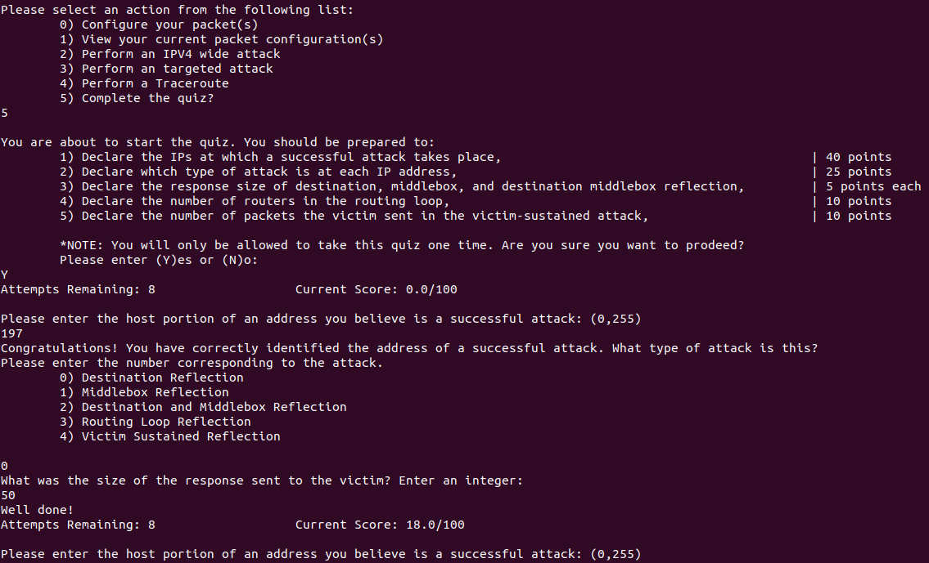
NS - Middlebox: Action 2.2.3
Complete the quiz.
Notes:
First off, start the quiz by entering in 5 and confirming that we want to take the quiz. Then take your smallest IP address and enter in the last three digits of the address, representing the host. If we go back to the list of the different types of amplifications, we can see from the descriptions that the one that produces the smallest response is Destination Reflection, choose that for this and that should prompt you for the size of the response sent to the victim. Enter the size of the response, in my case 50, and that should be the first 18 points!

Slide 42
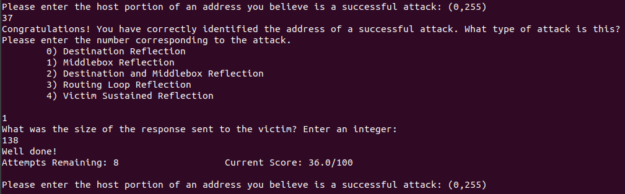
NS - Middlebox: Action 2.2.3
Complete the quiz.
Notes:
On to the second address, we enter the host once again, look at our list of types and determine that Middlebox Reflection is the one that has the 2nd smallest reflection size so we pick that option for the quiz. Once again we enter the size of the response sent to the victim which, once again, is just the size of the amplification, in my case 138. That should get you to 36 points now.

Slide 43
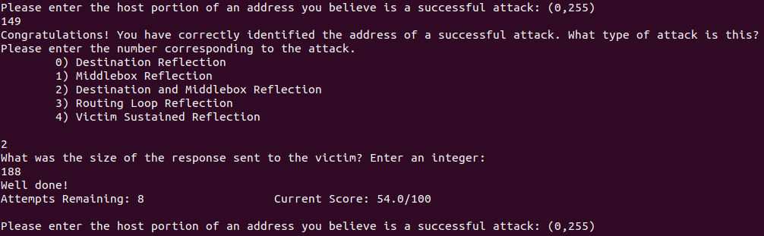
NS - Middlebox: Action 2.2.3
Complete the quiz.
Notes:
Next IP address. Same process, enter the host, check our list and find that the types are conspicuously in ascending order of size and that the third smallest is Destination and Middlebox Reflection. Choosing that option we’re now prompted for the size of the response which is, once again, the size we received. In my case 188 which you’ll notice is the sum of the sizes of the previous two reflections. You should now be up to 54 points.

Slide 44
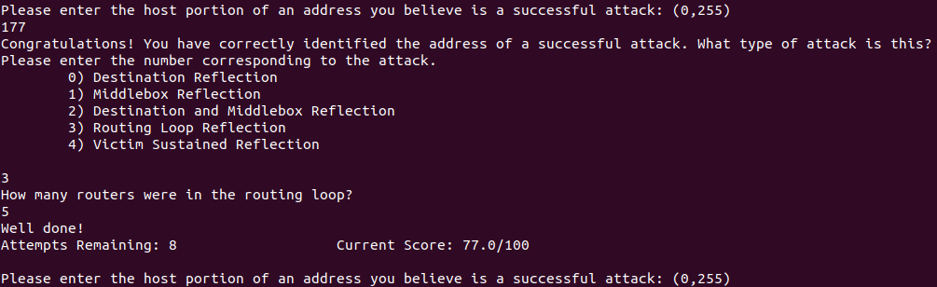
NS - Middlebox: Action 2.2.3
Complete the quiz.
Notes:
Now for our fourth smallest IP address, we take a look the list once more, find that it’s the routing loop reflection and this time we’re asked how many routers and not the packet size, what a change! If we go to our traceroute and look at the router IP addresses, we can count the number of unique IPs. For me, that was 5, getting me to a total of 77 points thus far. When counting up your number of routers, take care to make sure you’re counting just the routers and not the routers AND middleboxes.

Slide 45
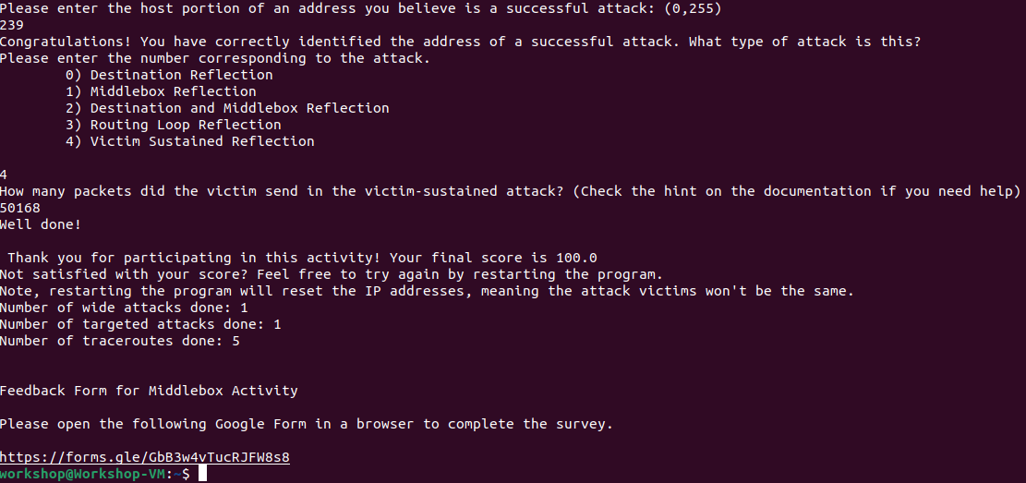
NS - Middlebox: Action 2.2.3
Complete the quiz.
Notes:
Now we’ve got our final IP address, we only have one option for the type of amplification for this address, that being the victim sustained reflection. Now for the quirky part of this one, the number of packets the VICTIM sent, not the middlebox or the routers. Since we are sending two packets at the same time, we need to take the floor of half the packets we see as a result of our simulation. For me, this is the floor of 100,337 / 2 which is 50,168. That should end the quiz for us and print out some statistics for us to observe. There’s additionally an optional feedback survey that we ask everyone to fill out for this activity, feel free to fill that out when you get a chance if you’d like.

Slide 46
NS - Middlebox: Action 2.2.4
Highlight the link in the terminal with your cursor
Copy with Ctrl+Shift+C
Open Firefox from the taskbar
Paste in the link
Continue to Task Set 3: Bayesian Nash Equilibrium
Notes:
Here’s some basic instructions on getting the link from the terminal to firefox if you’re not able to directly open the link from your terminal.

Slide 47
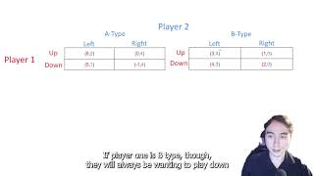
NS - Middlebox: Task Set 3
Notes:
Now before we jump into the game theory section, let’s take a look at the video that Jordan prepared for us.

Slide 48
NS - Middlebox: Task Set 3
Bayesian Nash Equilibrium
No incentive to change strategy based on prior beliefs
Notes:
Thank you Jordam, let’s do our own summaries of what Bayesian Nash Equilibrium is to really reinforce it for us. So Bayesian Nash Equilibrium only works when there’s no incentive for any of the involved parties to change their strategy based on prior beliefs.

Slide 49
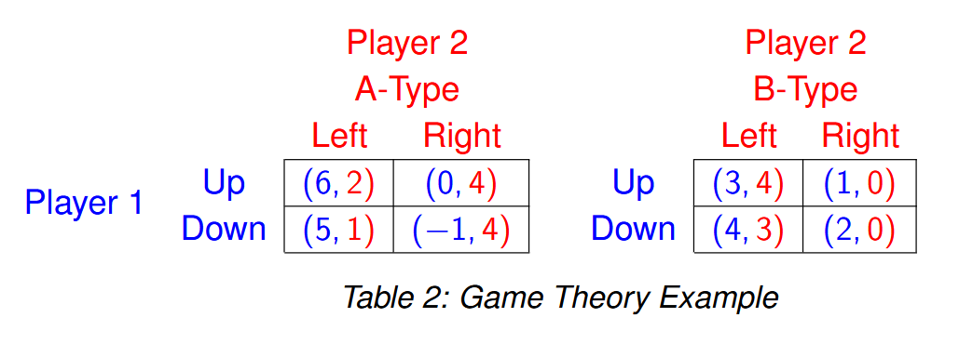
NS - Middlebox: Task Set 3
Notes:
Let’s take a look at our own example. Here we’ve got a game of two players, each with the option of taking two actions. Player 1 can either go up or down and player 2 can either go left or right. The catch here is that player 1 can be either A-Type or B-Type and based on Player 2’s belief on what kind of type player 1 is, their decisions will change. Take a second to look over these tables and see if you notice anything about them.

Slide 50
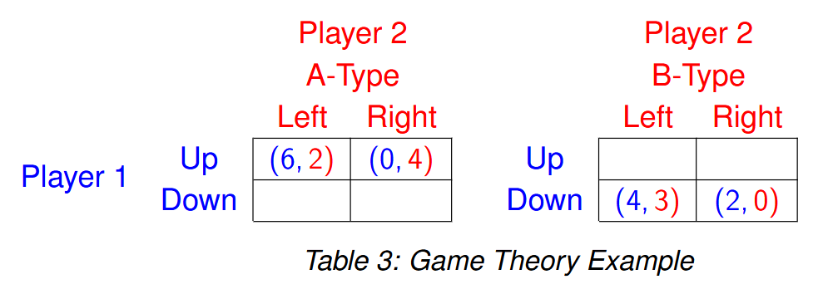
NS - Middlebox: Task Set 3
Notes:
Since Player 1 knows what type of player they are but player 2 doesn’t. Player 2 can see both tables, meanwhile player 1 can only see the table corresponding to their type. Player 2’s first step is to see what the dominant strategy for player 1 is for each of their types. We can see these dominating strategies in the image on screen.

Slide 51
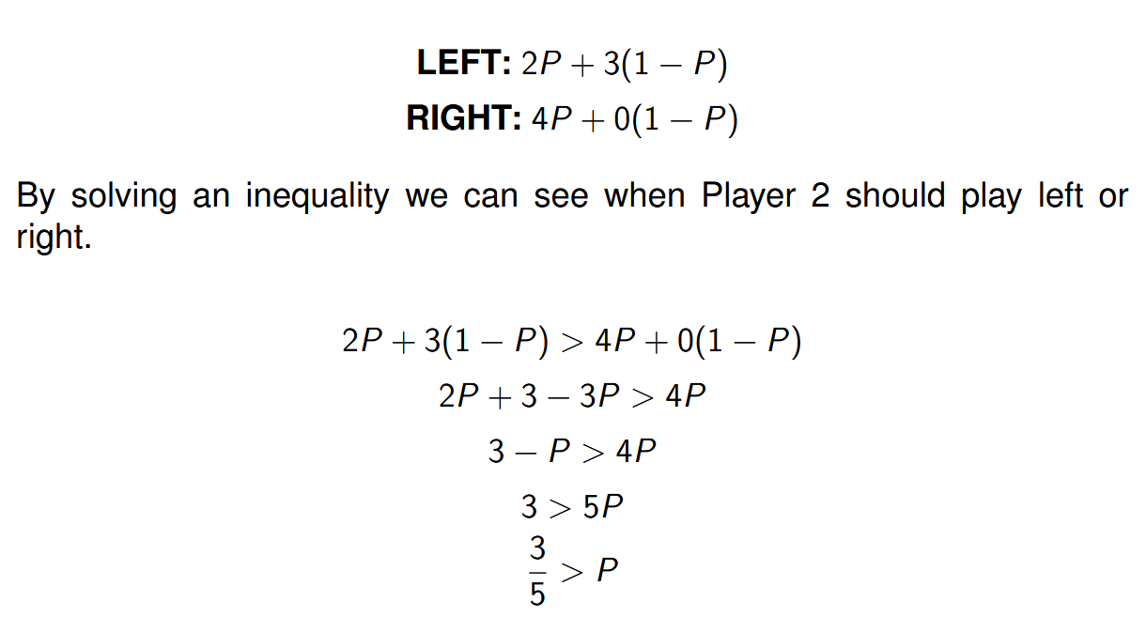
NS - Middlebox: Task Set 3
Notes:
Now we’ve got to calculate the utility of Player 2’s actions. We can create our inequalities by taking the expected value for each of player 2’s actions times the probability of the type and summing them together to get the total utility for that action. For example, Player 2 will get a utility of 2 if player 1 is the A-Type, we write this as 2 times P. Now if we look at the B-Type table, we see that player 2 gets a utility of 3, we write this as 3 times 1 minus P. The sum of these two is the total utility for the left action. We do the same process for the right action. We can then set them up in an inequality and solve for P to get our value for decision making. In this case we see that if P is greater than three fifths, player 2 should play the left action, otherwise they should play the right action.

Slide 52
NS - Middlebox: Task Set 3
Our hypothetical situation:
Country One (A-type)
Primary Target
Country Two (B-type)
Ally
2 Attack Methods
Old (less effective)
New (more effective, can’t use again)
Notes:
Now that we’ve gone through an example, let’s look at what our hypothetical situation is. We’ve got a server located in one of two countries but we don’t know which one. Country One is the primary target of our attack and Country Two is an ally that we don’t want to attack. If the server is in Country One, our target, we call this the A-Type, likewise, the server is B-Type if it is in the ally country, country two. We have two methods of attack, the older less effective method and the newer more effective method that will only work once. Our goal here is to weigh our options for each type of server and determine which method of attack we should go with that will have the highest chance of benefiting us.

Slide 53
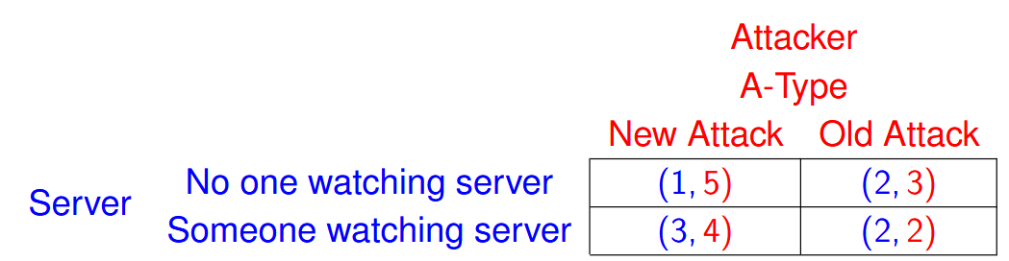
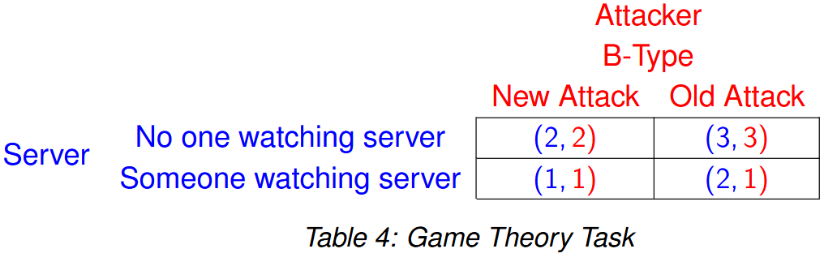
NS - Middlebox: Task Set 3
Notes:
Here, we’ve got this situation represented in tables. The server can either have someone watching the server or have no one watching the server and the attacker can either do the new or old attack.

Slide 54
NS - Middlebox: Action 3.2.1
Write your inequalities.
Notes:
Following the same approach as our example, let’s take 5 minutes to determine dominating strategies and set up our inequalities.

Slide 55
NS - Middlebox: Action 3.2.1
Write your inequalities.
New: 4P + 2(1-P)
Old: 2P + 3(1-P)
4P + 2(1-P) > 2P + 3(1-P)
Notes:
There is a chance that the Attacker will be either a-type or b-type. P is represented with this. There are still only two options for both Attacker and Server to choose, but Server does not know what type Attacker is. Server can only see whichever table their type is while Server can see both. Server must first see what the dominant strategy is for the Attacker in each scenario. This is quite simple though as with a-type up strictly dominates Someone watching server, and as b-type Someone watching server strictly dominates No one watching server. We can then setup our inequalities as shown above and then finally set up our equation itself, highlighted in orange.

Slide 56
NS - Middlebox: Action 3.2.2
Solve your inequalities.
Notes:
Now let’s take another few minutes to do some good old fashioned algebra and solve our inequality for P.

Slide 57
NS - Middlebox: Action 3.2.2
Solve your inequalities.
4P + 2(1-P) > 2P + 3(1-P)
4P + 2 - 2P > 2P + 3 -3P
2P + 2 > -P + 3
3P + 2 > 3
3P > 1
P > 1/3
Notes:
Here we can see our solution. So when P is greater than 1/3 Server should play New Attack, but when it is less than 1/3 they should play Old Attack.

Slide 58
NS - Middlebox: Action 3.2.3
Answer the following questions.
Which attack should you use if there is a ½ chance the server is owned by Country One?
Which attack should you use if there is a ⅓ chance the server is owned by Country One?
Which attack should you use if there is a ¼ chance the server is owned by Country One?
Notes:
Now here’s a few questions to make sure we’ve got a good understanding of what our inequality means. If there’s a 50% chance the server is owned by the target country, which attack do we go with?

Slide 59
NS - Middlebox: Action 3.2.3
Answer the following questions.
Which attack should you use if there is a ½ chance the server is owned by Country One?
New Attack because 1/2 is greater than 1/3.
Which attack should you use if there is a ⅓ chance the server is owned by Country One?
Which attack should you use if there is a ¼ chance the server is owned by Country One?
Notes:
We go with the New Attack since our inequality for P is satisfied.
Now, if there’s a 33% chance the server is owned by the target country, which attack do we go with?

Slide 60
NS - Middlebox: Action 3.2.3
Answer the following questions.
Which attack should you use if there is a ½ chance the server is owned by Country One?
New Attack because 1/2 is greater than 1/3.
Which attack should you use if there is a ⅓ chance the server is owned by Country One?
Old Attack because 1/3 is not greater than 1/3.
Which attack should you use if there is a ¼ chance the server is owned by Country One?
Notes:
We should use the Old attack since our inequality isn’t satisfied.
Now, if there’s a 25% chance the server is owned by the target country, which attack do we go with?

Slide 61
NS - Middlebox: Action 3.2.3
Answer the following questions.
Which attack should you use if there is a ½ chance the server is owned by Country One?
New Attack because 1/2 is greater than 1/3.
Which attack should you use if there is a ⅓ chance the server is owned by Country One?
Old Attack because 1/3 is not greater than 1/3.
Which attack should you use if there is a ¼ chance the server is owned by Country One?
Old Attack because 1/4 is not greater than 1/3.
Notes:
Once again, the old attack since our inequality isn’t satisfied.

Slide 62
NS - Middlebox: Action 3.2.4
Navigate back to the browser and complete the survey.
Notes:
Now would be the ideal time to do the survey if you’d like to, no pressure if you don’t feel like doing it. The survey is also anonymous so feel free to be as critical as you’d like.

Slide 63
NS - Middlebox: Summary
Reflection-based attacks are possible over UDP AND TCP now
5 kinds of middlebox reflections
How to identify them
Large “vulnerability”
Major consequences for nations with high censorship
Notes:
While people are filling out the survey, let’s recap a little. We’ve gone over what reflection based attacks are and covered how they’re possible over TCP and not just UDP anymore. We’ve gone over the five types of reflections and seen how we can identify them. While doing so, we’ve seen how large of a vulnerability this is. From a single attacker sending out a single packet of 1 megabyte in size, we saw responses of over 100 gigabytes getting sent back. One of the points that we really want to reinforce here is that for nations with a high amount of censorship, this can be a massive consequence as there could be some intentionally vulnerable middleboxes and domains and this attack could be used to quickly, easily, and effectively block someone from accessing the internet by blocking their ports.

Slide 64
Questions?
NS - Middlebox
Notes:
Now that we’ve finished the first lab, are there any questions?

